Slide 1
LLMs to Clock Cycles (nl2sql)
Bell Labs Coding Challenge

Slide 2
Approach to Fine-Tune LLMs
Preparation and Setup
Data Preprocessing and Exploration
Model Fine-Tuning
Evaluation and Testing
GUI-Development

Slide 3
Abstractions for Optimization
The three layers of possible optimization
High-Level Optimization
Hyper-Parameters
Low-Level Optimization

Slide 4
High-Level Optimization…
Model and Dataset: Choosing apt base model and dataset to avoid too many pre-processing steps and a difficult setup.
Metrics and Testing: Implement early stopping based on validation loss, and use model checkpointing to save the best model. Choose custom test cases that reflect specific business scenarios.
Adaptor-Rank Estimation: Use a rank estimation algorithm to perform empirical testing over a range of ranks.
Fine-Tuning Techniques: Choose a suitable techniques like LoRA, qLoRA, PEFT, Iterative-Refinement, BitNet b1.58, etc.
Parallelizing and Automating the Workflow: Build a parallelized and automated pipeline for the entire fine-tuning workflow as it’s an iterative process.

Slide 5






Hyper-Parameters
Parameters that affect the entire workflow of fine-tuning.
Rank
Quantization Precision
Learning Rate
Batch Size
Epochs
Max Sequence Length

Slide 6
Low-Level Optimization…
Model Quantization: Reducing the precision of the model’s weights from 32-bit floating point to 16-bit floating point or 8-bit Int.
Model Pruning: Removing redundant or less important weights from the model, reducing its size and inference time.
Mixed Precision Inference: Using both FP32 and FP16 operations during inference, allowing for faster computations while maintaining accuracy.
Caching Mechanisms and Hardware Specific Optimizations: Leveraging capabilities like AVX-512, Tensor Cores, TPUs, sophisticated Caches, GPUs, Threads, ONNX, etc.
Batch Inference (Parallelism): Process multiple inputs simultaneously, leveraging parallelism to improve throughput.

Slide 7
Performance Evaluation
Inference Speed
Throughput
Model Size and Memory Usage
Quantization Impact
Deployment Considerations
Hardware Profiling

Slide 8
Business Metrics…
Query Success Rate: Measuring the percentage of correct query results without errors and the correct data. Also include time efficiency.
Use Case Simulation: Divide the test dataset into a real-world business scenarios and then run the model. Generate numerically precise reports to compare the results.
Evaluation of Query Accuracy: Involvement of human-experts to generate the SQL queries for the scenarios and categorize the observed errors for better understanding. (where the model fails)
Assess Business Impact: Training Evaluate whether the model helps business users make faster and more informed decisions. Can setup continuous monitoring or reporting tools to keep an eye on the model every time it’s used.

Slide 9
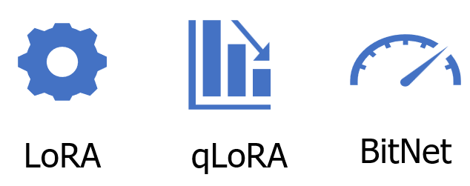
Fine-Tuning Techniques

Slide 10
My Strategy
Model Selection and Data Preparation
Model: t5-small
Datasets: spider, sql-create-context
Fine-Tuning Technique Selection
LoRA Parameters
qLoRA Parameters
Fine-Tuned Model Evaluation
BLEU Score
Performance Metrics
GUI in Flask

Slide 11
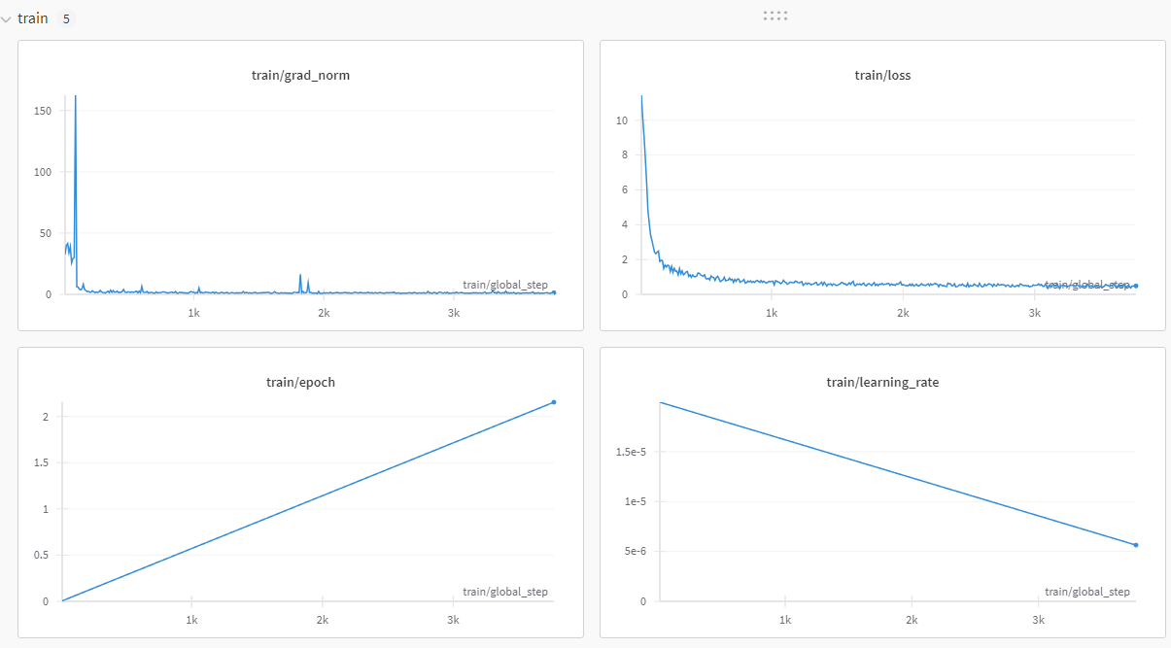
Process – Only on CPU

Slide 12
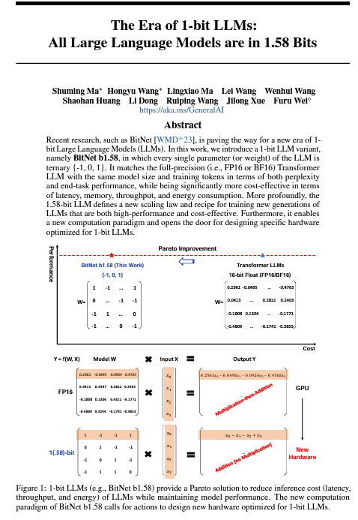
BitNet 1.58b Implementation

Slide 13
Thanks!

Slide 14
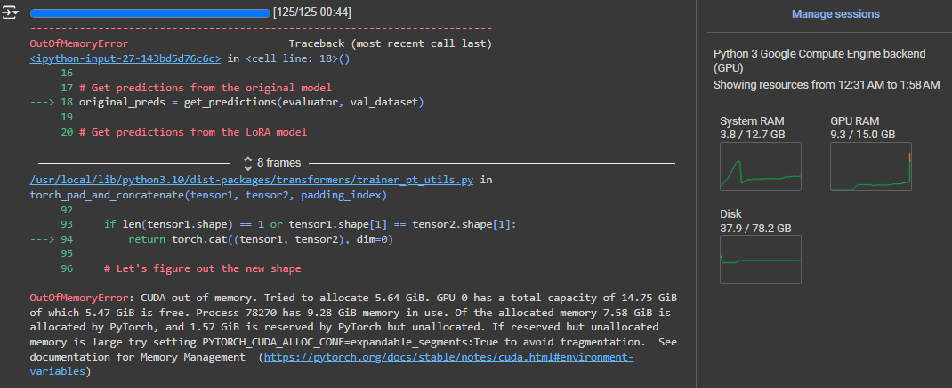
Process

